Slide 1
The Basics of Excel: Part 1
Spring Semester 2020
Notes:
About me
- Kimberly Rubens, Second year Goldman School of Public Policy Student
Excel enthusiast – also available as a consultant via D-Lab for an individual Excel related questions
Fun fact:

Slide 2
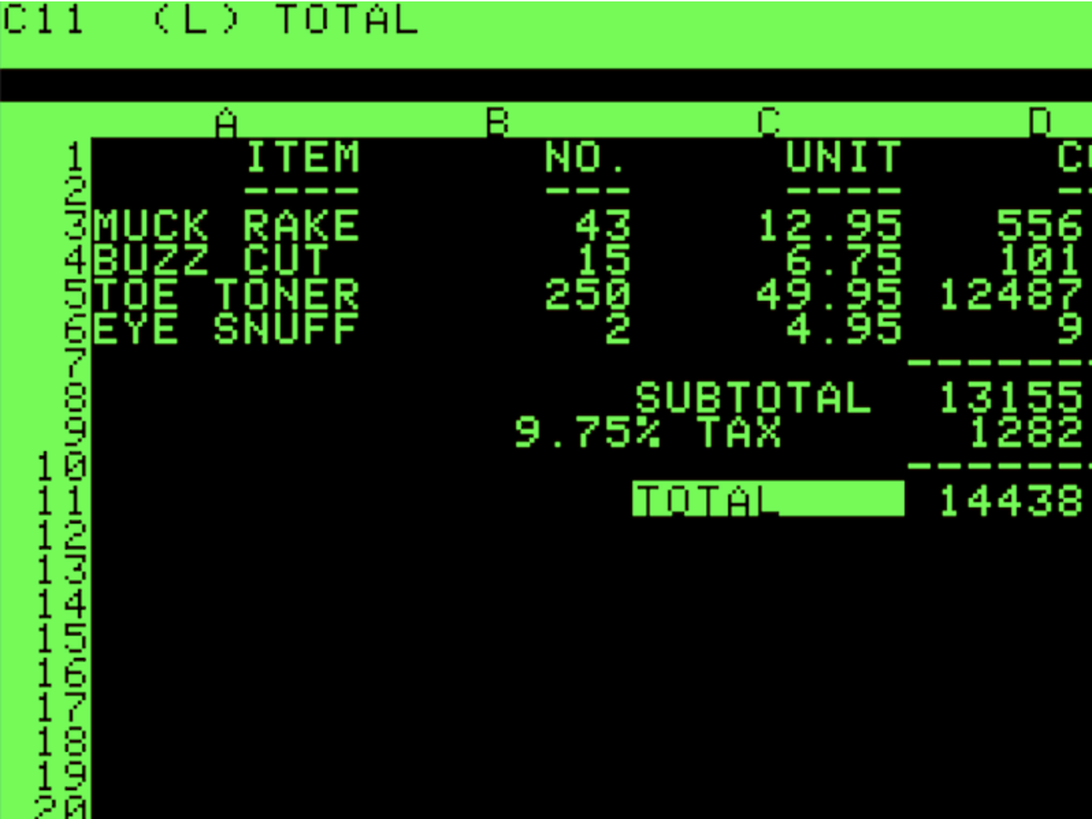
Pro Tips
Keyboard Shortcuts are your best friend.
Listen to this super interesting 20 minute podcast
Download the most up to date version of Excel available for free through Berkeley software portal
Notes:
On the last point – Excel makes slight changes to locations and functionalities of its tools based on the version that you’re working in. The content is designed to be run in the most up to date version of Excel. You can still do everything that I teach in the class on your version of Excel, however I kindly ask that if you can’t find a button or tool or something else we’re going over, to please hold your question until it’s time for individual work. The class is paced such that after every new tool, you’ll have a few minutes to practice the skill. That is the perfect time to ask me a question about the version of Excel that you use.

Slide 3
Agenda
Tool-Bar walkthrough
Basic Formulas
Data Organizing
More Excel Formulas

Slide 4
Agenda
Tool-Bar walkthrough
Basic Formulas
Data Organizing
More Excel Formulas
Notes:
Home tab, where most formatting options live
Insert tab,
Page Layout, v important, where you can choose theme colors for your worksheet, most applicable to visualizations
Formulas – fun fact Excel contains more than 400 formulas, they’re organized here by their operation, but as you’ll see in the next part, the formulas will automatically populate in a drop down below the cell that you’re typic in
Data Tab – where you can do a lot of data cleaning, organizing, as well as different types of analyses
View – The freeze pane buttons and where you can record macros, which we’ll cover the basics of in Part 2

Slide 5
Agenda
Tool-Bar walkthrough
Basic Formulas
Data Organizing
More Excel Formulas

Slide 6

Excel Formula Rules to Live By
Always start with equal sign
Formula options will automatically pop up as you type
Use TAB to accept a formula
enter will exit you from the cell
Zoom in, save your eyes

Slide 7
About the Data: Welcome to California!
Census Data for each of California’s 58 counties that can be downloaded here
Pro Tip: When using Census Data, try to use 5-year pooled estimates whenever possible, it’ll be the most precise. Here is more information about the different types of estimates offered by Census.
Census Data is a human-made system, therefore it is inherently vulnerable to bias. Read more here. Or here. Or here. Or here. Or here.

Slide 8
Different Ways to Use Formulas
Manually input
Referencing other cells by typing each cell individually
Referencing other cells by typing in the column you’d like to use
Clicking and dragging the cursor
Keyboard shortcuts
Notes:
I’ll briefly demonstrate and you can follow along as I show you how to do the first four. The content in the class is written to encourage you to do keyboard shortcuts but if you feel like that isn’t working for you, you can use one of the other methods.

Slide 9


Sum: adds numbers
1. Select cell that will hold the value | <F2> | <Fn + F2>
2. Type: “= s”
3. Navigate to and accept suggested formula | <Tab> | <Tab>
4. Use arrow keys to navigate to first cell of data set
5. Select the rest of the column of data | <Ctrl + Shift + Down> | <CMD + Shift + Down>
Practice | Dlab_Part1 → “Sum”
Notes:
A note about the first keyboard shortcut in step 1, you don’t have to do it to start typing in a cell, as long as the cell is highlighted by your green cursor, it means that any typing you do will happen in that cell. It’s a useful keyboard shortcut if you want to edit a cell after you’re done typing in it
Also don’t forget about CMD or CTRL Z

Slide 10
Average: calculates mean
1. Select cell that will hold the value | <F2> | <Fn + F2>
2. Type: “= a”
3. Navigate to and accept suggested formula | <Tab> | <Tab>
4. Use arrow keys to navigate to first cell of data set
5. Select the rest of the column of data | <Ctrl + Shift + Down> | <CMD + Shift + Down>
Practice | Dlab_Part1→ “Average”
Notes:
Three ways:
1. Drag square with two arrows down
2. Type – maybe you don’t have that many columns, or you know that your data set contains 513 observations/entries in a column
3. Keyboard Shortcuts!: S into Cell + C first cell + S select rest of the row

Slide 11
Min / Max: identifies minimum / maximum value in a data set
1. Select cell that will hold the value | <F2> | <Fn + F2>
2. Type: “=m”
3. Navigate to and accept suggested formula | <Tab> | <Tab>
4. Use arrow keys to navigate to first cell of data set
5. Select the rest of the column of data | <Ctrl + Shift + Down> | <CMD + Shift + Down>
Practice | Dlab_Part1 → “Min-Max-Range”
Notes:
Three ways:
1. Drag square with two arrows down
2. Type – maybe you don’t have that many columns, or you know that your data set contains 513 observations/entries in a column
3. Keyboard Shortcuts!: S into Cell + C first cell + S select rest of the row

Slide 12
Range: aka subtraction
1. Select cell that will hold the value | <F2> | <Fn + F2>
2. Type “= ”
3. Use arrows to navigate to cell that contains the max value
4. Type “ – “
5. Use arrows to navigate to cell that contains the min value
6. Hit “enter”
Practice | Dlab_Part1 → “Min-Max-Range”
Notes:
Three ways:
1. Drag square with two arrows down
2. Type – maybe you don’t have that many columns, or you know that your data set contains 513 observations/entries in a column
3. Keyboard Shortcuts!: S into Cell + C first cell + S select rest of the row

Slide 13
Spreading Formulas: identifies and repeats one formula
 | (1) Hover over bottom right corner of cell containing the formula you’d like to repeat
 | (2) Wait for black plus sign to appear
 | (3) Drag bar across row or column that you’re trying to fill in
Practice | DLab_Part1 → “Spreading”

Slide 14
Agenda
Tool-Bar walkthrough
Basic Formulas
Data Organizing
More Excel Formulas

Slide 15


Slide 16
About this section’s data: Civil Rights Policy
The Office for Civil Rights, based in the Department of Education, requires school districts to publish data related to access to resources, punishment practices, school expenditures, & teacher experience, among other metrics. This database can be accessed here
The most recent data is available from 2013. There is 2015-2016 school year data, however it is not available yet. And who’s to say when it will be.
This is self-reported data.

Slide 17
Relative Referencing
Purpose | When you would like the formula, or cell referencing to change based on where you are in the workbook
Example | =SUM(C1:Z1)
Practice | DLab_Part1 → “Relative Referencing”

Slide 18
Absolute Referencing
Purpose | When you do not want the formula, or cell referencing to change based on where you are in the workbook
Column Locked | =SUM($C1:$C260)
Row Locked | =SUM(C$1:C$260)
Both Locked | =SUM($C$1:$C$260)
Practice | DLab_Part1 → “Absolute Referencing”

Slide 19
Sort
Purpose | Quickly organize data by different columns
Where? | Under the Data Tab of an Excel sheet
How? | Select the entire block of data in the worksheet Click the Sort button under Data – use shortcut! CMD/Ctrl + A Make your selection
Pro Tip | Make sure you select the entire sheet of Data, or else you will ruin your data. Just kidding, you can always click undo, but make sure you’re selecting all the data.
Practice | DLab_Part1 → “Sort” Sort the Data by category, A – Z Sort the Data by category, Z - A Sort the Data by LEA Sort the Data by a race category of your choosing, largest to smallest

Slide 20
Concatenate
Purpose | Combine two cells together
Combine to one word | =CONCATENATE(FirstName, LastName) → FirstNameLastName
Combine, yet keep spacing | =CONCATENATE(FirstName, “ “, LastName) → FirstName LastName
Practice | DLab_Part1 → “Concatenate”

Slide 21
Copy & Pasting Values Only
Purpose: So you don’t lose your mind when you see a #REF! or #VALUE! Or #N/A! error
Instructions: 1. Copy and paste the row/column/data you’re trying to move
2. Watch the errors appear
3. Don’t freak out
4. Click on the little clipboard icon and select: “Values Only”

Slide 22


Slide 23
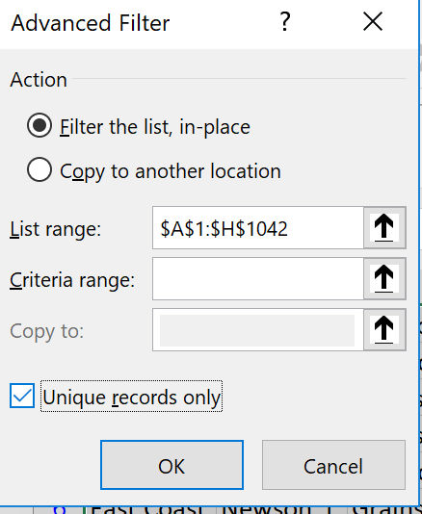
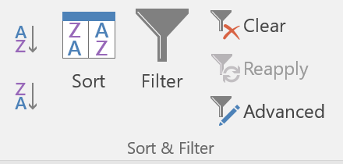
Filter Duplicates
Purpose | To filter out specific data, in this case we will remove duplicates
Filter | 1. Select the advanced filter button 2. Select Unique Records only 3. Click “ok”
Reset Data | Keyboard shortcut to undo OR clear button under “Data”
Practice | DLab_Part1→ “Filter Duplicates”
Notes:
In here show how to use the filter button

Slide 24
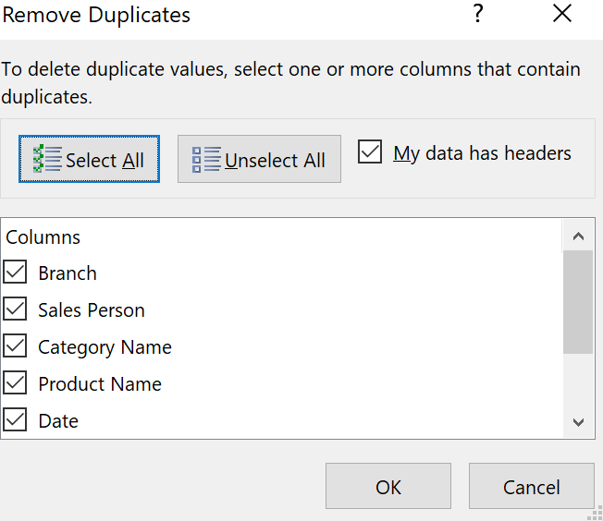
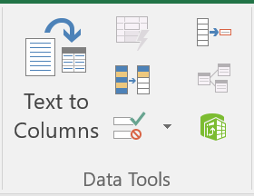
Remove Duplicates
 | Select remove duplicates icon under “Data” Select data to remove
Practice | DLab_Part1 → “Remove Duplicates” Remove all Duplicates Remove all Duplicate dates Remove all Duplicate quantities Pro Tip: Undo will reset data after removing duplicates
Notes:
The difference between Filter Duplicates and Remove Duplicates is that Remove duplicates permanently deletes them.

Slide 25
Text to Columns
 | Select data you want to split, use keyboard shortcut! Under data, select “Text to Columns” button Keep “delimited,” click next Select “space” as your delimiter Click “finish”
Practice | DLab_Part1 → “Text to Columns”

Slide 26

Copy & Pasting Values Only
Purpose: So you don’t lose your mind when you see a #REF! or #VALUE! Or #N/A! error

Slide 27
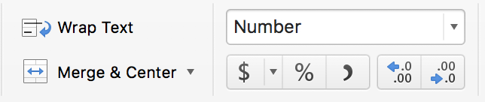
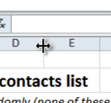
Formatting Pro-Tips
Choose your own number formatting!
Under Home Tab
Get rid of decimals! Or add them!
Under Home Tab
Expand a cell! Hover over line in between columns & double-click.
Color - Code Worksheets
Right click on the tab you want to change the color of and select “Tab Color”
Notes:
To practice, let’s all return to the “Sum” sheet

Slide 28
Converting PDF to Excel
Free Online Convertor | https://www.pdftoexcel.com/
Adobe Acrobat | Open PDF in Acrobat “Export PDF” Decide where to save document Save Adobe is available for free through U.C. Berkeley! Instructions to download at a later date are here.

Slide 29
Agenda
Tool-Bar walkthrough
Basic Formulas
Data Organizing
More Excel Formulas

Slide 30
About this section’s data: Criminal Justice
Today’s data comes from the following sources
SF Open Data Portal
CA DOJ Open Data Portal
NYC Open Data Portal
NYC Stop & Frisk Open Data Portal
Most of the data sets go back to the early 2000s, some cities have historic crime data
This data can be hard to process. And I’m not just talking about the size of the Excel files. There are lots of on-campus resources for support, also feel free to come talk to me during office hours or shoot me an email!

Slide 31


Slide 32
Count
Purpose: Counts the total number of times something happens
Notes:
I am just going to demonstrate the basic form of count, don’t worry, we’ll have tons of time to practice
So we see, that from 2001 to 2009, there were 131,000 calls of domestic violence in the state of California

Slide 33
Countif
Purpose: Counts the total number of times something happens, conditioned on a specific criteria
Notes:
Criteria can be either a numerical argument, or a text string.
We will practice both

Slide 34
Countif
Purpose: Counts the total number of times something happens, conditioned on a specific criteria
=COUNTIF ( range, criteria)

Slide 35
Countif
Research Question: How many times does San Francisco County show up in this data?
=COUNTIF ( range, “criteria”)
Where do I want to look?
i.e. County data for Domestic Violence (DV) Reports
Range: B2:B65536
What do I want to look for?
i.e. The number of times a county reported DV
Criteria: “San Francisco County”
Notes:
Criteria doesn’t always have to be text. It can take the form of numerical arguments.
Criteria must always be in quotes, even if it’s a numerical argument.
You’re going to have to do some scrolling here. Make sure you click back into the cell when you’re trying to finish a formula

Slide 36
Countif
1. Navigate to cell that will hold the data
2. Type “=Count”
3. Navigate to and accept “COUNTIF” | <Tab> | <Tab>
4. Use arrows to toggle into first cell of data set
5. Select rest of the column of data | Ctrl + Shift + Down | CMD + Shift + Down
6. Type “ , ”
7. Type your criteria: “San Francisco County”
8. Hit Enter or Tab

Slide 37
Countif(s)
Practice: DLab_Part1 → Countif

Slide 38
Countif(s)
Purpose: Counts the total number of times something happens, conditioned on as many criteria as you want.

Slide 39
Countif(s)
Research Question: How many times does the total number of victims in a Hate Crime Incident exceed 5 in the year 2016?

Slide 40
Countif(s)
Research Question: How many times does the total number of victims in a Hate Crime Incident exceed 5 in the year 2016?
COUNTIFS(criteria_range1, criteria1, [criteria_range2, criteria2]…)

Slide 41
Countif(s)
Research Question: How many times does the total number of victims in a Hate Crime Incident exceed 5 in the year 2016?
COUNTIFS(criteria_range1, criteria1, [criteria_range2, criteria2]…)
criteria_range1=
A5: A10413
criteria1 =
“2016”
Criteria_range2 =
D5:D10413
Criteria2 =
“>5”
41

Slide 42
Countif(s)
Practice: DLab_Part1 → Countifs

Slide 43


Slide 44
Sumif
Purpose: Sums a selected range, conditioned on a specific criteria
Notes:
Criteria doesn’t always have to be text. It can take the form of numerical arguments.

Slide 45
Sumif
Purpose: Sums a selected range, conditioned on a specific criteria
=SUMIF ( range, criteria, [sum_range])
Notes:
Criteria doesn’t always have to be text. It can take the form of numerical arguments.

Slide 46
Sumif
Research Question: How many suspects were accused of robbery?
=SUMIF ( range, criteria, [sum_range])
Notes:
Criteria doesn’t always have to be text. It can take the form of numerical arguments.

Slide 47
Sumif
Research Question: How many suspects were accused of robbery?
=SUMIF ( range, criteria, [sum_range])
Where do I want to look to set my filter?
i.e. MostSeriousUcr
Range: G5:G10413
What am I filtering by?
i.e. The number of times a county reported DV
Criteria: “Robbery”,
What am adding up?
i.e. TotalNumberSuspects
sum_range: F5:F10413
47
47
Notes:
Criteria doesn’t always have to be text. It can take the form of numerical arguments.

Slide 48
Sumif
1. Navigate to cell that will hold the data
2. Type “=Sum”
3. Navigate to and accept “SUMIF” | <Tab> | <Tab>
4. Select first cell of range
5. Select rest of the column of data | Ctrl + Shift + Down | CMD + Shift + Down
6. Type “ , ”
7. Enter your criteria: “San Francisco County”,
8. Enter your sum_range | Repeat steps 4 & 5 | Repeat steps 4 & 5
Hit <Tab> or <Enter>

Slide 49
Sumif
Practice: DLab_Part 1→ “Sumif”

Slide 50
Sumif(s)
Purpose: Sum a range of data, conditioned on as many criteria as you want.

Slide 51
Sumif(s)
Research Question: How many white people were suspected of a hate crime in 2016?

Slide 52
Sumif(s)
Research Question: How many white people were suspected of a hate crime in 2016?
SUMIFS(sum_range, criteria_range1, criteria1, [criteria_range2, criteria2]…)
sum_range =
E7: E10415
criteria_range1=
A7: A10415
criteria1 =
“2016”
criteria_range2 =
D5:D10415
criteria2 =
“White”
52
52
Notes:
This is an annoying formula because for just one argument for SUMIF, the sum range goes at the end of the formula, but here it’s at the beginning

Slide 53
Sumif(s)
Practice: DLab_Part1 → “Sumif(s)”

Slide 54
Thank you!!

